Slide 1
Canis Lupus Familiaris (Dog)
By Brianna Kil

Slide 2
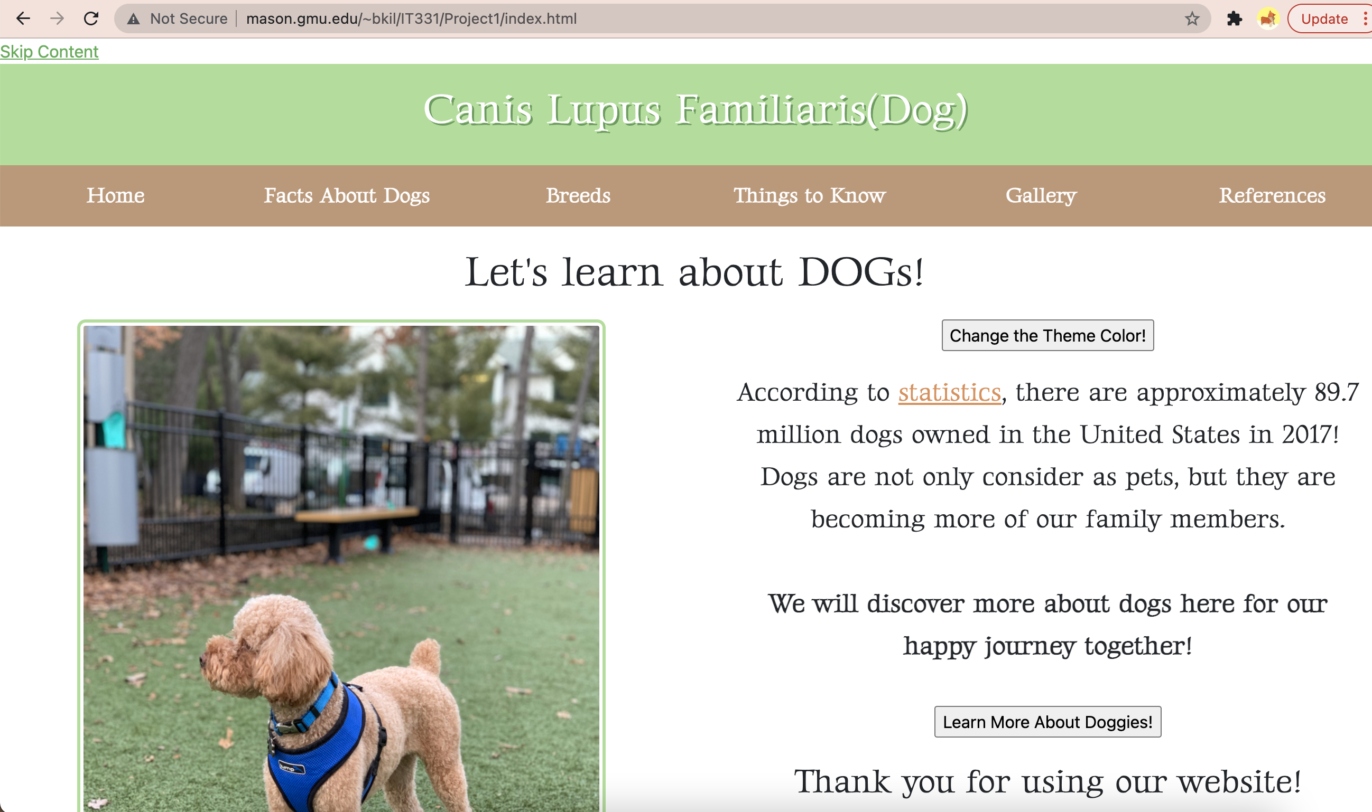
index.html

Slide 3
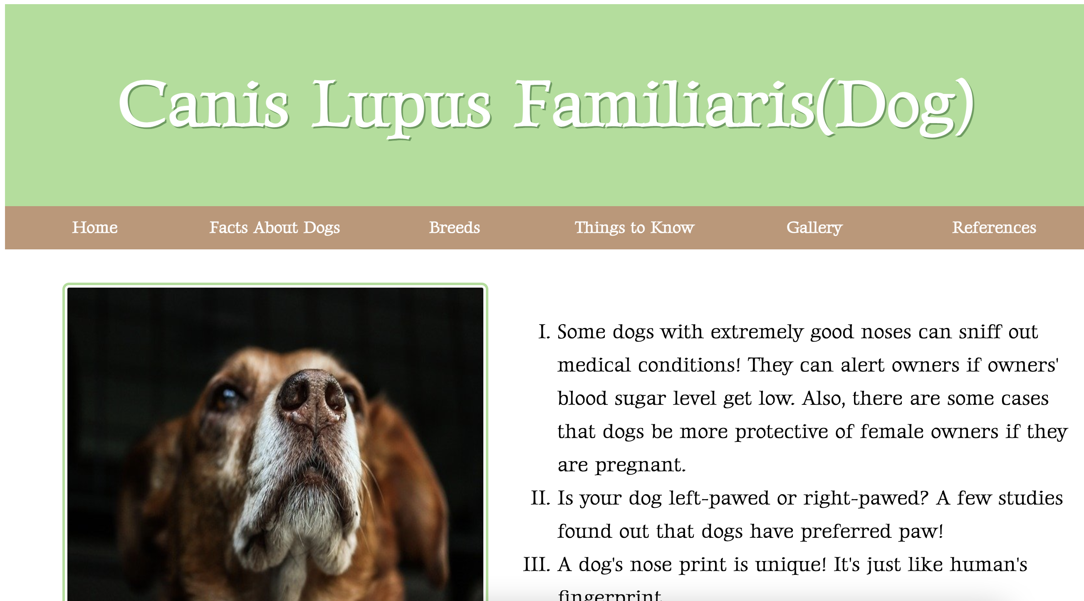
facts.html

Slide 4
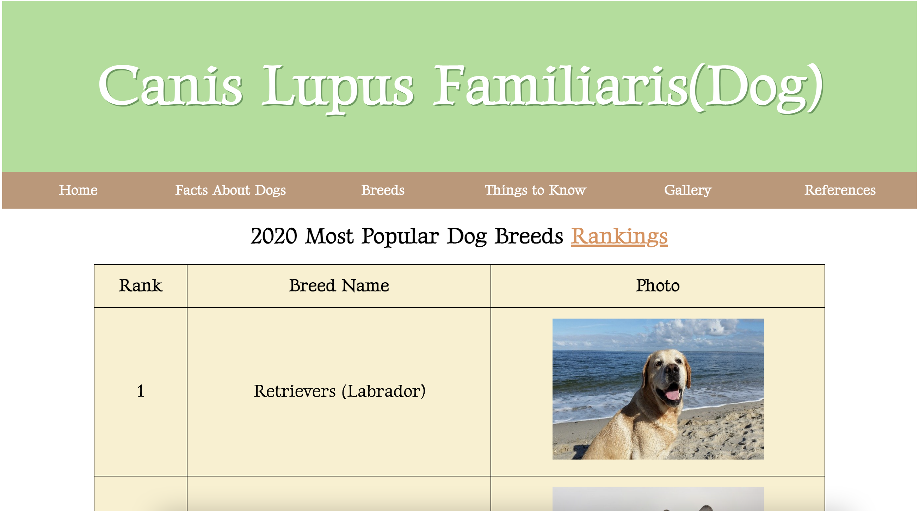
breeds.html

Slide 5
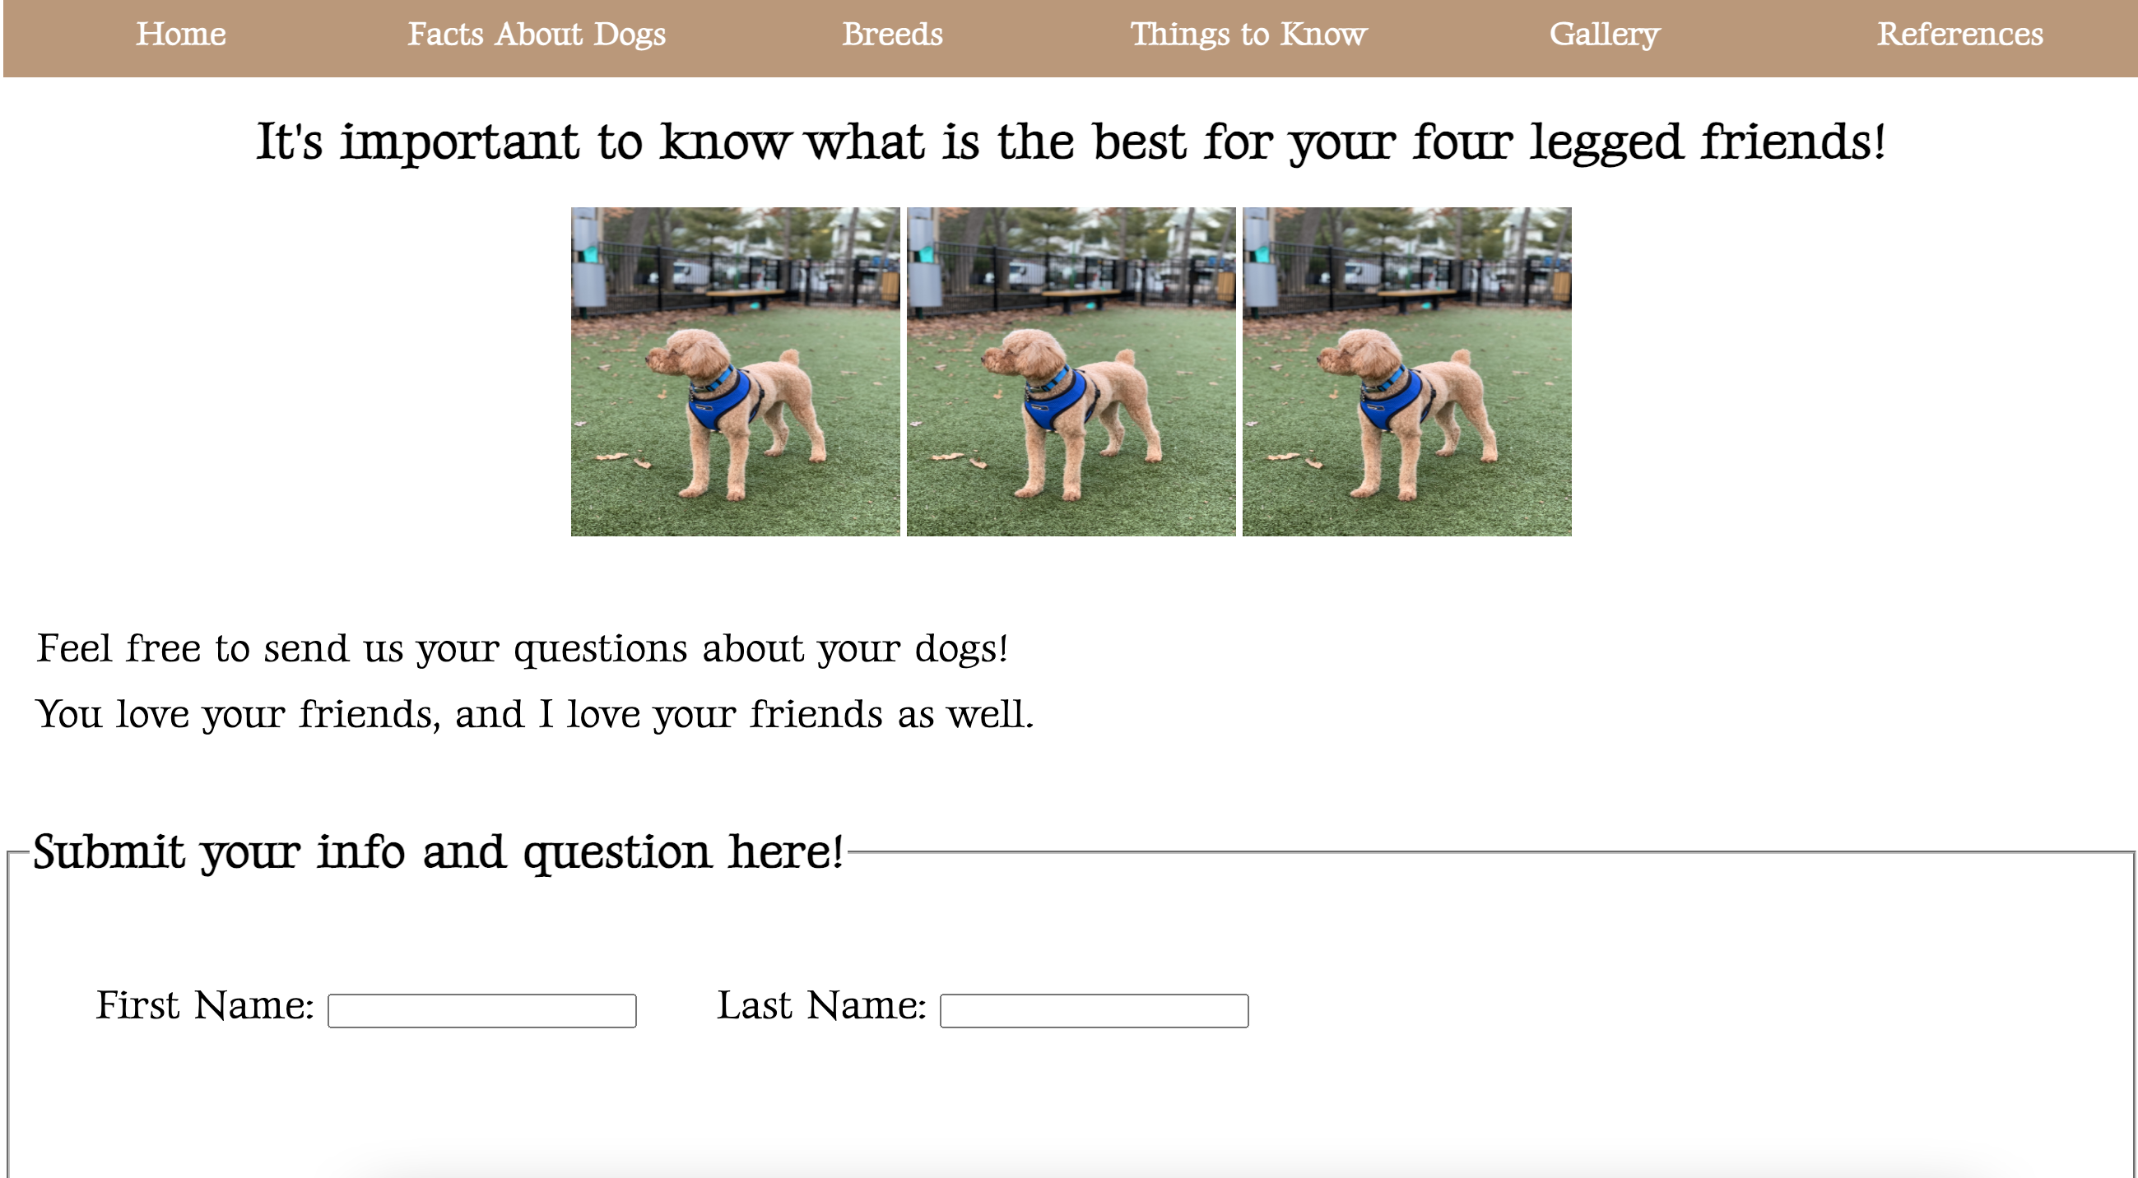
thingsToKnow.html

Slide 6
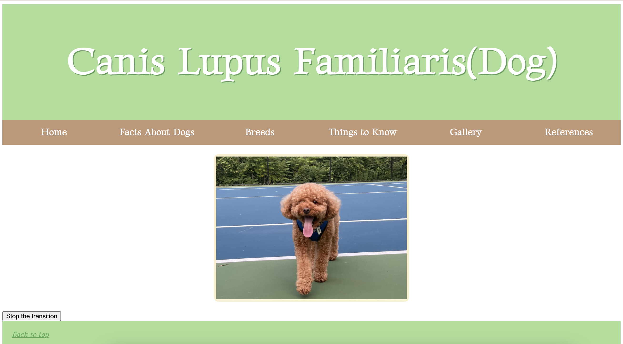
gallery.html

Slide 7
Let’s move on to the demonstration!
http://mason.gmu.edu/~bkil/IT331/Project1/index.html

